Slide 1
1.6 Functions
Department of CSE

Slide 2
Objectives
To understand the concept of modularization.
To know about the types of functions.
To study about formal arguments and actual arguments.
To understand the need of passing arguments to function.
Department of CSE

Slide 3
Agenda
Introduction to Function
Types of C Functions
Function naming rule in C
General Form of a Function
Parameters / Arguments
Scope of a Function
Returning Value – Control from a Function
Three Main Parts of a Function
Categorization based on Arguments and Return value
Calling Functions – Two Methods
Creating user defined header files
Storage classes
Summary
Department of CSE

Slide 4
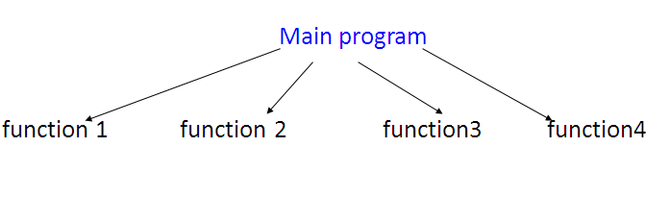
Introduction to Functions
Benefits of Using Functions:
It provides modularity to the program.
Easy code reusability. You just have to call the function by its name to use it.
In case of large programs with thousands of code lines, debugging and editing becomes easier if you use functions.
Credits: http://www.studytonight.com/c/types-of-function-calls.php
Department of CSE

Slide 5
Contd..
A function is independent:
  It is “completely” self-contained
  It can be called at any place of your code and can be ported to another program
    reusable - Use existing functions as building blocks for new programs
    Readable - more meaningful
    procedural abstraction - hide internal details
    factoring of code- divide and conquer
Department of CSE

Slide 6
Contd..
A function:
receives zero or more parameters,
performs a specific task, and
returns zero or one value
A function is invoked / called by name and parameters
Communication between function and invoker code is through the parameters and the return value
  In C, no two functions can have the same name
Department of CSE

Slide 7
Types of C Functions
Library function
User defined function
Library function
Library functions are the in-built function in C programming system
For example:
main() - - The execution of every C program
printf() - prinf() is used for displaying output in C.
scanf() - scanf() is used for taking input in C.
Department of CSE
Notes:
Pls include .h files and the impt lib functions available in them
e.G MATH library
Include examples to illustrate use of important library functions

Slide 8
Some of the math.h Library Functions
sin() → returns the sine of a radian angle.
cos() → returns the cosine of an angle in radians.
tan() → returns the tangent of a radian angle.
floor() → returns the largest integral value less than or equal to x.
ceil() → returns the smallest integer value greater than or equal to x.
pow() → returns base raised to the power of exponent(x^{y}).
Some of the conio.h Library Functions
clrscr() → used to clear the output screen.
getch() → reads character from keyboard.
textbackground() → used to change text background
Department of CSE

Slide 9
Contd..
User defined function
Allows programmer to define their own function according to their requirement.
Advantages of user defined functions
It helps to decompose the large program into small segments which makes programmer easy to understand, maintain and debug.
If repeated code occurs in a program. Function can be used to include those codes and execute when needed by calling that function.
Programmer working on large project can divide the workload by making different functions.
Department of CSE

Slide 10
Function naming rule in C
Name of function includes only alphabets, digit and underscore.
First character of name of any function must be an alphabet or underscore.
Name of function cannot be any keyword of c program.
Name of function cannot be global identifier.
Name of function cannot be exactly same as of name of function in the same scope.
Name of function is case sensitive
Name of function cannot be register Pseudo variable
Department of CSE

Slide 11
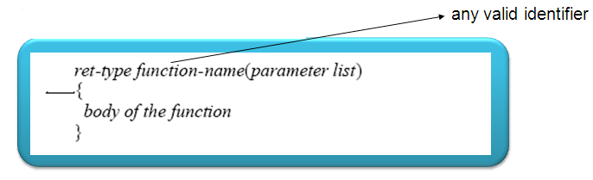
The General Form a Function
The ret-type specifies the type of data that the function returns.
A function may return any type ( default: int )of data except an array
The parameter (formal arguments) list is a comma-separated list of variable names and their associated types
The parameters receive the values of the arguments when the function is called
A function can be without parameters:
An empty parameter list can be explicitly specified as such by placing the keyword void inside the parentheses
Department of CSE

Slide 12
More about formal argument/parameter list ..………
(type varname1, type varname2, . . . , type varnameN)
You can declare several variables to be of the same type
By using a comma separated list of variable names.
In contrast, all function parameters must be declared
individually, each including both the type and name
f(int i, int k, int j)
f(int i, k, float j) Is it correct?
/* wrong, k must have its own type specifier */
Department of CSE

Slide 13
Scope of a function
Each function is a discrete block of code. Thus, a function defines a block scope:
A function's code is private to that function and cannot be accessed by any statement in any other function except through a call to that function.
Variables that are defined within a function are local variables
A local variable comes into existence when the function is entered and is destroyed upon exit
A local variable cannot hold its value between function calls
Department of CSE

Slide 14
Contd..
The formal arguments /parameters to a
function also fall within the function's scope:
is known throughout the entire function
comes into existence when the function is
called and is destroyed when the function
is exited.
Even though they perform the special task of receiving the value of the arguments passed to the function, they behave like any other local variable
Department of CSE

Slide 15
Returning value, control from a function
    If nothing returned
      return;
      or, until reaches right curly brace
    If something returned
      return expression;
      Only one value can be returned from a C function
A function can return only one value, though it can return one of several values based on the evaluation of certain conditions.
Multiple return statements can be used within a single function
(eg: inside an “if-then-else” statement…)
The return statement not only returns a value back to the calling
function,
it also returns
control back to the calling function
Department of CSE

Slide 16
Three Main Parts of a Function
Function Declaration (Function prototype)
Function Definition
Function Call
Department of CSE

Slide 17
Structure of a C program with a Function
Function prototype giving the name, return type and the type of formal
arguments
main( )
{
……….
Call to the function:
Variable to hold the value returned by the function = Function name with actual arguments
………
}
Function definition:
Header of function with name, return type and the type of formal arguments as given in the prototype
Function body within { } with local variables declared , statements and return statement
Department of CSE

Slide 18
Function Prototype
Functions should be declared before they are used
Prototype only needed if function definition comes after use in
program
Function prototypes are always declared at the beginning of
the program indicating :
name of the function, data type of its arguments &
data type of the returned value
  return_type function_name ( type1 name1, type2 name2, ..., typen namen );
Department of CSE

Slide 19
Function Definition
Function header
return_type function_name ( type1 name1, type2 name2, ...,typen namen)
{
local variable declarations
.... otherstatements...
return statement
}
Function Body
Department of CSE

Slide 20
Function call
A function is called from the main( )
A function can in turn call a another function
Function call statements invokes the function which means the program control passes to
that function
Once the function completes its task, the program control is passed back to the calling
environment
Department of CSE

Slide 21
Contd..
Variable = function_name ( actual argument list);
Or
Function_name ( actual argument list);
Function name and the type and number of arguments must match with that of the function declaration stmt and the header of the function definition
Examples:
result = sum( 5, 8 ); display( ); calculate( s, r, t);
Department of CSE

Slide 22
Return statement
To return a value from a C function you must explicitly return
it with a return statement
return <expression>;
The expression can be any valid C expression that resolves
to the type defined in the function header
add( int a, int b) add( int a, int b)
{ {
int c = a+ b;;
return (a + b); return ( c );
} }
Ex: Function call: int value = add(5,8)
Here, add( ) sends back the value of the expression (a + b) or value of c to main( )
Department of CSE

Slide 23
Examples
Function Prototype Examples
    double squared (double number);
    void print_report (int);
    int get _menu_choice (void);
Function Definition Examples
    double squared (double number)
    {
    return (number * number);
    }
    void print_report (int report_number)
    {
    if (report_nmber == 1)
    printf(“Printer Report 1”);
    else
    printf(“Not printing Report 1”);
    }
Department of CSE

Slide 24
Example C program..
#include<stdio.h>
float average(float, float, float);
int main( )
Function prototype
{
float a, b, c;
printf(“Enter three numbers please\n”);
scanf(“%f, %f, %f”,&a, &b, &c);
printf(“Avg of 3 numbers = %.3f\n”, average(a, b, c) );
return 0;
}
Function call
Department of CSE

Slide 25
Contd..
The definition of function average:
float average(float x, float y, float z) //local variables x, y, z
{
float r; // local variable
r = (x+y+z)/3;
return r;
}
Function header
Function Body
Department of CSE

Slide 26
Categorization based on arguments and return value
Function with no arguments and no return value
Function with no arguments and return value
Function with arguments but no return value
Function with arguments and return value.
Credits : http://www.programiz.com/c-programming/types-user-defined-functions
Department of CSE

Slide 27
Calling Functions – Two methods
Call by value
  Copy of argument passed
  Changes in function do not effect original
  Use when function does not need to modify argument
    Avoids accidental changes
Call by reference
  Passes original argument
  Changes in function effect original
  Only used with trusted functions
Department of CSE

Slide 28
Call by Value
When a function is called by an argument/parameter which is not a pointer the copy of the argument is passed to the function.
Therefore a possible change on the copy does not change the original value of the argument.
Example:
Function call func1 (a, b, c);
Function header int func1 (int x, int y, int z)
Here, the parameters x , y and z are initialized by the values of a, b and c
int x = a
int y = b
int z = c
Department of CSE

Slide 29
Example C Program
void swap(int, int );
main( )
{
int a=10, b=20;
swap(a, b);
printf(“ %d %d \n”, a, b);
}
void swap (int x, int y)
{
int temp = x;
x= y;
y=temp;
}
Department of CSE

Slide 30
Intricacies of the preceding example
In the preceding example, the function main() declared and initialized two integers a and b, and then invoked the function swap( ) by passing a and b as arguments to the function swap( ).
The function swap( ) receives the arguments a and b into its parameters x and y. In fact, the functionswap( ) receives a copy of the values of a and b into its parameters.
The parameters of a function are local to that function, and hence, any changes made by the called function to its parameters affect only the copy received by the called function, and do not affect the value of the variables in the called function. This is the call by value mechanism.
Department of CSE

Slide 31
Call by Reference
When a function is called by an argument/parameter which is a pointer (address of the argument) the copy of the address of the argument is passed to the function
Therefore, a possible change on the data at the referenced address changes the original value of the argument.
Will be dealt later in detail…
Department of CSE

Slide 32
Illustration for creating user defined header files using user created functions
Make Your Own Header File ?
Step1 : Type this Code
int add(int a,int b)
{
return(a+b);
}
In this Code write only function definition as you write in General C Program
Step 2 : Save Code
Save Above Code with [.h ] Extension .
Let name of our header file be myhead [ myhead.h ]
Compile Code if required.
Department of CSE

Slide 33
Step 3 : Write Main Program
#include<stdio.h>
#include"myhead.h“
main() {
int num1 = 10, num2 = 10, num3;
num3 = add(num1, num2);
printf("Addition of Two numbers : %d", num3);
}
Here,
Instead of writing < myhead.h> use this terminology “myhead.h”
All the Functions defined in the myhead.h header file are now ready for use .
Directly call function add(); [ Provide proper parameter and take care of return type ]
Note : While running your program precaution to be taken :
Both files [ myhead.h and sample.c ] should be in same folder.
Department of CSE

Slide 34
Storage Classes
A storage class defines the scope (visibility) and life time of variables and/or functions within a C Program.
Automatic variables → auto
External variables → extern
Static variables → static
Register variables → register
auto - Storage Class
auto is the default storage class for all local variables.
{
int Count;
auto int Month;
}
The example above defines two variables with the same storage class. auto can only be used within functions, i.e. local variables.
Department of CSE

Slide 35
extern - Storage Class
These variables are declared outside any function.
These variables are active and alive throughout the entire program.
Also known as global variables and default value is zero.
static - Storage Class
The value of static variables persists until the end of the program.
It is declared using the keyword static like
static int x;
static float y;
It may be of external or internal type depending on the place of there declaration.
Static variables are initialized only once, when the program is compiled.
Department of CSE

Slide 36
register - Storage Class
These variables are stored in one of the machine’s register and are declared using register keyword.
eg. register int count;
Since register access are much faster than a memory access keeping frequently accessed variables in the register lead to faster execution of program.
Don’t try to declare a global variable as register. Because the register will be occupied during the lifetime of the program.
Department of CSE

Slide 37
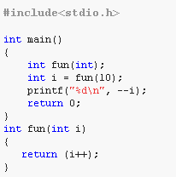
1. Predict the output of the program.
Department of CSE

Slide 38
1. Solution
Answer: 9
Explanation:
Step 1: int fun(int); Here we declare the prototype of the function fun().
Step 2: int i = fun(10); The variable i is declared as an integer type and the result of the fun(10) will be stored in the variable i.
Step 3: int fun(int i){ return (i++); } Inside the fun() we are returning a value return(i++). It returns 10. because i++ is the post-increement operator.
Step 4: Then the control back to the main function and the value 10 is assigned to variable i.
Step 5: printf("%d\n", --i); Here --i denoted pre-increement. Hence it prints the value 9.
Department of CSE

Slide 39

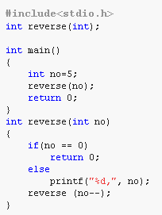
2. What will be the output of the program?
Department of CSE

Slide 40
2. Solution
Answer: Infinite loop
Explanation:
Step 1: int no=5; The variable no is declared as integer type and initialized to 5.
Step 2: reverse(no); becomes reverse(5); It calls the function reverse() with '5' as parameter.
The function reverse accept an integer number 5 and it returns '0'(zero) if(5 == 0) if the given number is '0'(zero) or else printf("%d,", no); it prints that number 5 and calls the function reverse(5);.
The function runs infinetely because the there is a post-decrement operator is used. It will not decrease the value of 'n' before calling the reverse() function. So, it calls reverse(5) infinitely.
Note: If we use pre-decrement operator like reverse(--n), then the output will be 5, 4, 3, 2, 1. Because before calling the function, it decrements the value of 'n'.
Department of CSE

Slide 41
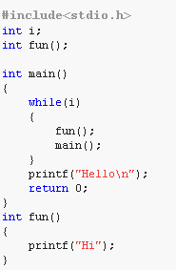
3. Predict the output of the program.
Department of CSE

Slide 42
3.Solution
Answer: Hello
Explanation:
Step 1: int i; The variable i is declared as an integer type.
Step 1: int fun(); This prototype tells the compiler that the function fun() does not accept any arguments and it returns an integer value.
Step 1: while(i) The value of i is not initialized so this while condition is failed. So, it does not execute the while block.
Step 1: printf("Hello\n"); It prints "Hello".
Hence the output of the program is "Hello".
Department of CSE

Slide 43
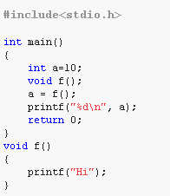
1. Point out the error in the program.
Department of CSE

Slide 44
1. Solution
Answer: Error: Not allowed assignment
Explanation:
The function void f() is not visible to the compiler while going through main() function. So we have to declare this prototype void f(); before to main() function. This kind of error will not occur in modern compilers.
Department of CSE

Slide 45
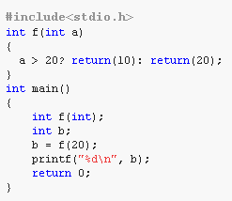
2. Point out the error in the program.
Department of CSE

Slide 46
2. Solution
Answer:
Error: return statement cannot be used with conditional operators
Explanation:
In a ternary operator, we cannot use the return statement. The ternary operator requires expressions but not code.
Department of CSE

Slide 47
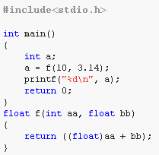
3. There is an error in the below program. Which statement will you add to remove it?
Department of CSE

Slide 48
3. Solution
Answer: Add prototype: float f(int, float);
Explanation:
The correct form of function f prototype is
float f(int, float);
Department of CSE

Slide 49
Summary
Discussed the modularization techniques in C.
Illustration of functions with different parts – Prototype, Call and Definition.
Discussed formal and actual parameters and passing mechanism.
Department of CSE
Notes:
Give an illustration and explanation for creating user defined header files using user created functions
Show how this can be included in a regular c Program (e.g. using # include “myheader.h” in a program) one simple example is enough

